Slide 1
Level 10
Mathematical Modelling
Lesson 2
Interest on Interest
Prof. Jill Brown
Notes:
Explicit teaching of number facts
This session will demonstrate explicit teaching approaches to improve student outcomes, focusing on reasoning and fluency with basic facts. Participants will engage in hands-on strategies to direct student learning, including demonstrations of new content, scaffolding practice, and monitoring progress. The session will also highlight how effective questioning techniques can deepen students’ understanding of key concepts

Slide 2
The problem of the iPad?
Imagine your parents, knowing they would need to get you an iPad for Years 7-10, had invested $750 at 5.25% p.a. over 3 years whilst you were in Year 3-6.
Was this a smart move on their part?

Slide 3
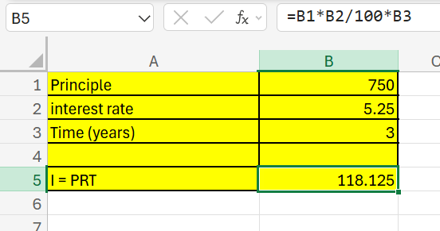
Simple Interest
The iPad problem
Imagine your parents, knowing they would need to get you an iPad for Years 7-10, had invested $750 at 5.25% p.a. over 3 years whilst you were in Year 3-6.
Was this a smart move on their part?

Slide 4
The iPad problem
Imagine your parents, knowing they would need to get you an iPad for Years 7-10, had invested $750 at 5.25% p.a. over 3 years whilst you were in Year 3-6.
Was this a smart move on their part?
Interest on interest
What if at the end of year 1, the interest is calculated, added to the $750 and at the end of the next year the interest is calculated on this new amount?
Set up a spreadsheet to investigate

Slide 5
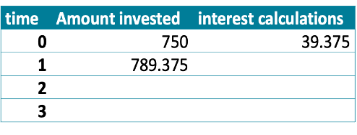
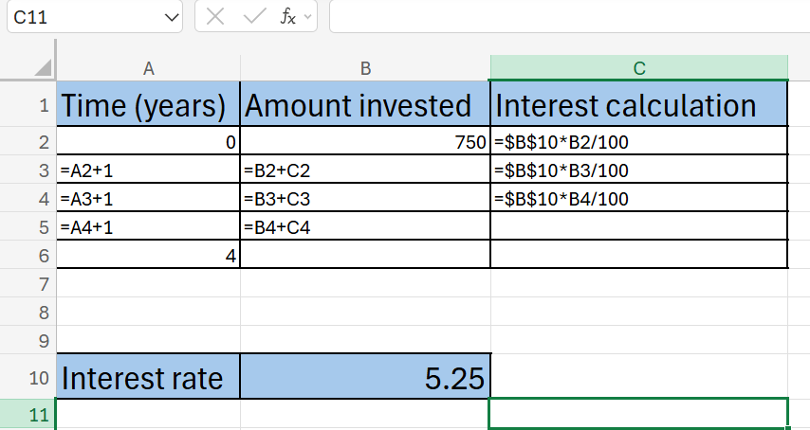
Sample spreadsheet entries
Notes:
A reminder to use the ‘fill down function’ by using dragging the box on the right hand bottom corner of the cell
A reminder that using the dollar sign before the cell reference means the formula always points to this cell.

Slide 6
Facilitate communication and reasoning
Compare the impact of the ‘interest on your interest’ calculations to the simple interest calculation.
Record what you notice between the two calculations for interest.
Next, consider if the interest is paid more often: start with 6 monthly
How do you need to modify the spreadsheet? What changes? What stays the same?
What if interest is calculated:
monthly
Fortnightly
Weekly
Daily
Adjust your spreadsheet to show the difference in the calculations
Notes:
Sample solutions are provided in the accompanying resource

